Slide 1

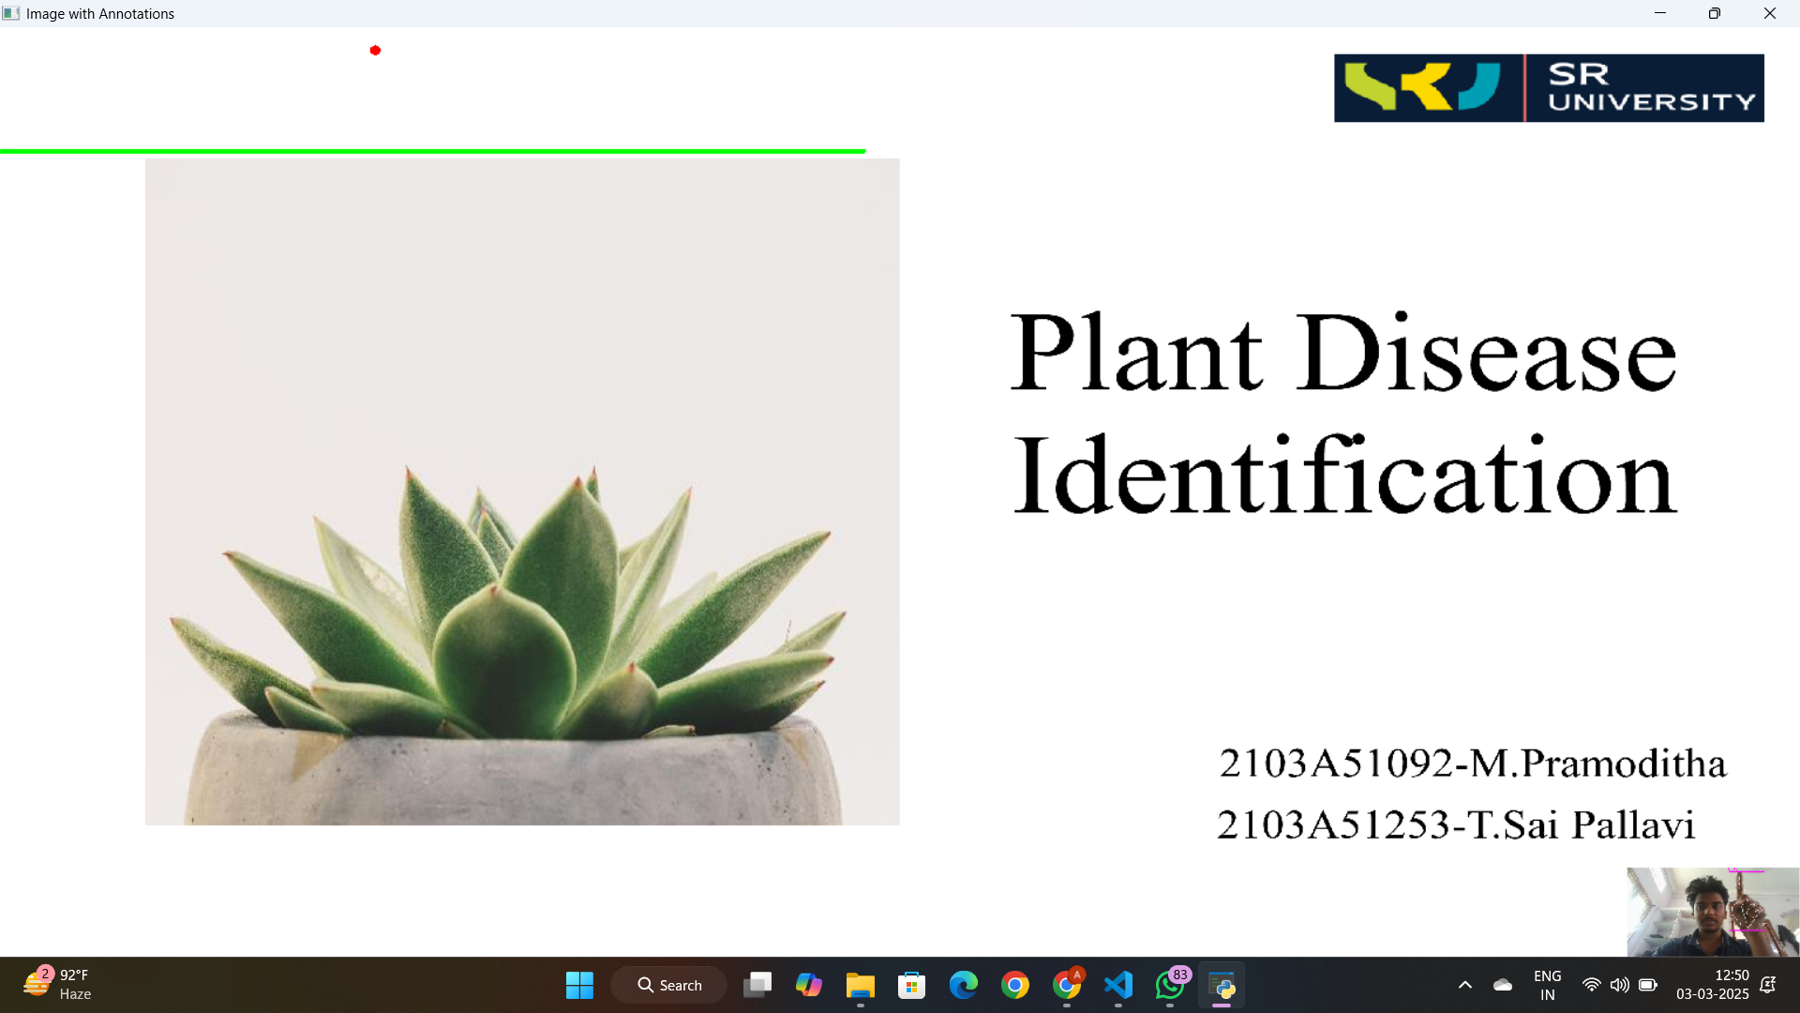
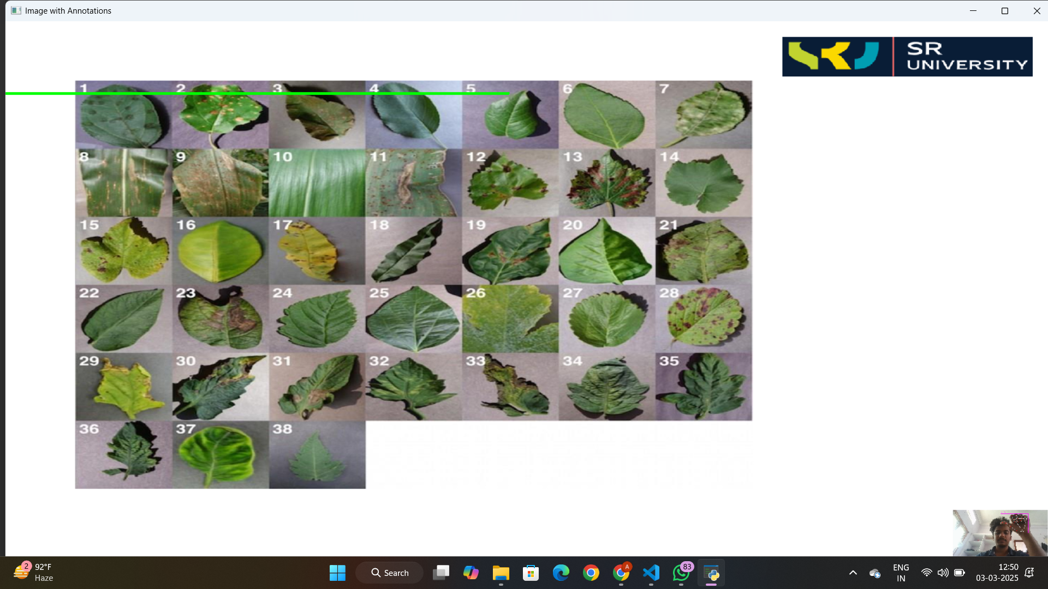
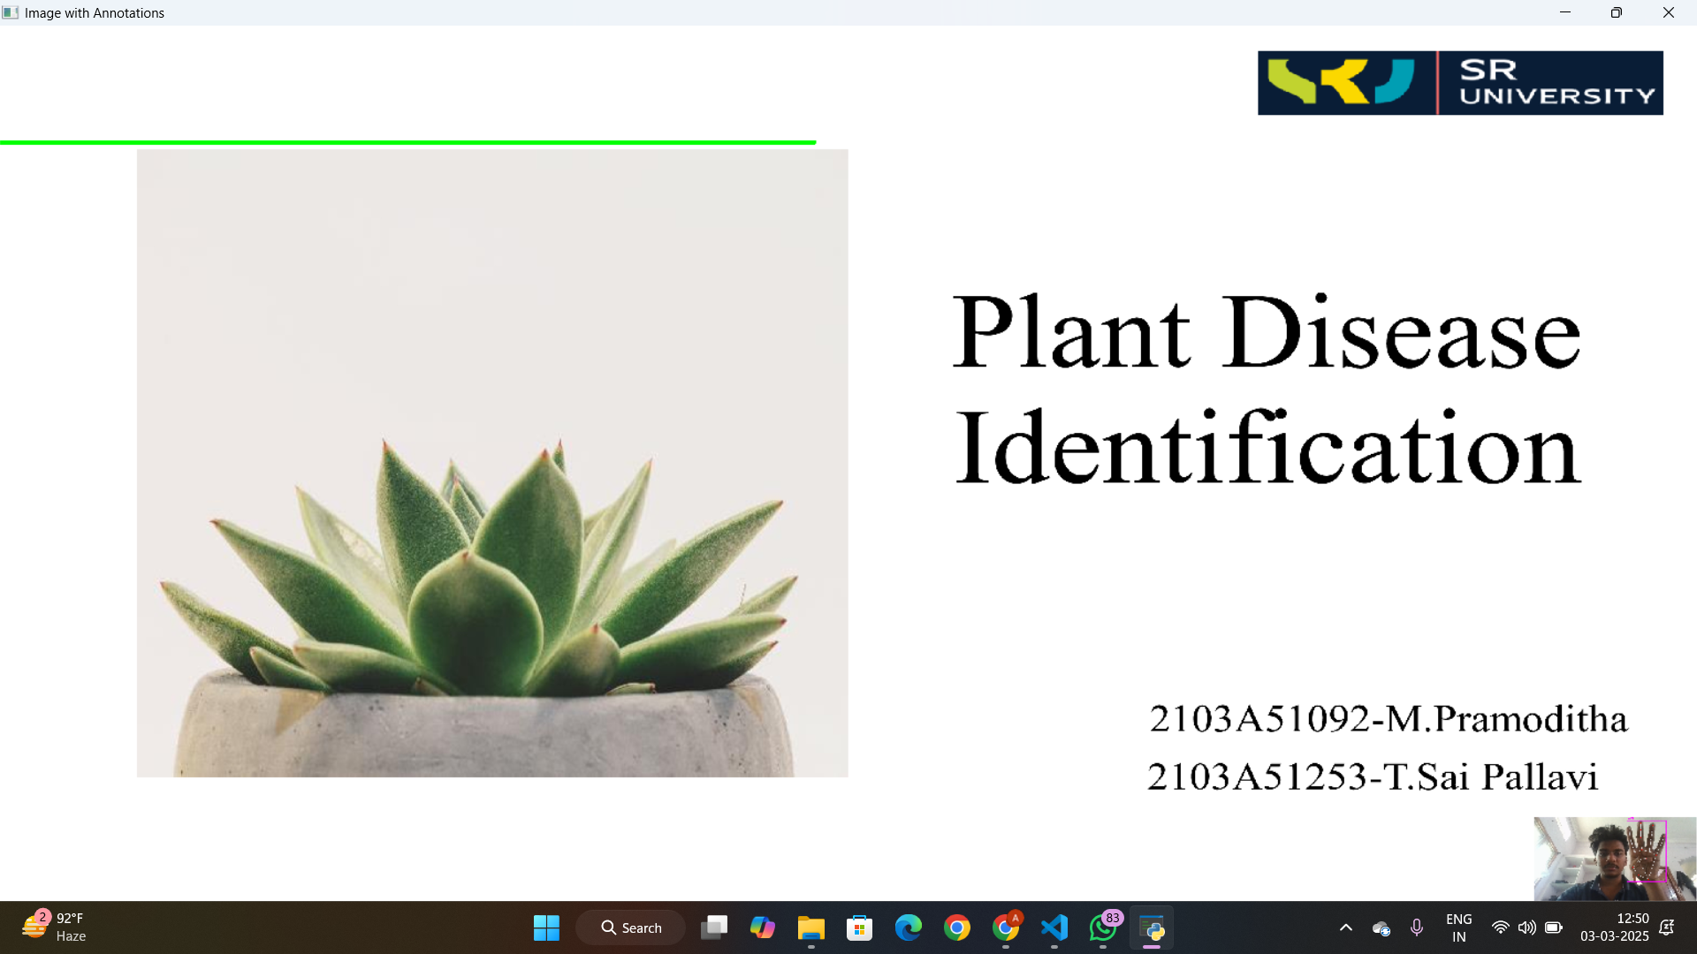
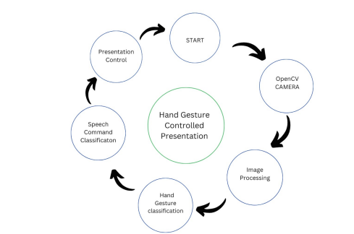
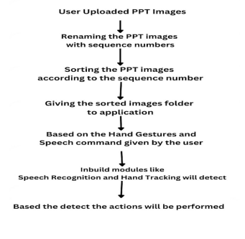
GESTURE CONTROLLED PRESENTATION SYSTEM WITH SPEECH RECOGNITION AND WEB INTERACTION
SR UNIVERSITY
TEAM-104
RAHMAN – 2103A51057 ,MANIKANTA– 2103A51073, VIVEK – 2103A51088 ,VARSHITH – 2103A51089, NAVEEN – 2103A51267 ,CHARY -2103A51268
GUIDE: MR.GOTTE RANJITH KUMAR
ABSTRACT
PROPOSED PLAN
The system uses hand gestures and speech recognition to control presentations. Users select a folder of PNG slides, which are renamed for navigation. Gestures allow slide navigation, annotation, and erasing, while voice commands manage slides (e.g., "next," "previous," "delete"). Real-time feedback enhances interactivity in presentations.
EXISTING METHOD | PRESENT APPROACH
Manual Navigation. Digital Pens or Highlighters. Touchscreen Monitors. | Data Collection and Preprocessing. Hand Gesture Recognition. Speech Recognition Integration. Gesture-to-Action Mapping, Error Handling and Robustness.
INTRODUCTION
Our Interactive Presentation System combines computer vision, speech recognition, and intuitive design. Using Open CV for hand gesture tracking and Speech Recognition for voice commands, users can navigate slides, annotate, and issue commands like "next" or "delete." The system enhances engagement and interactivity, offering a dynamic, user-friendly experience ideal for classrooms, boardrooms, and conferences to elevate presentations.
RESULTS
OBJECTIVES
Develop Hand Gesture Recognition | Enhance Presenter Mobility and Interaction
Integrate Speech Recognition | Boost Audience Engagement
Seamless Integration with Presentation Software | Create User-Friendly Interface
ARCHITECTURE OF CURRENT APPROACH
CONCLUSION
Implementing an interactive slideshow presentation system with hand gesture and speech recognition presents challenges, including ensuring the accuracy and reliability of both mechanisms. Factors like background noise, lighting conditions, and accent variations can impact performance. Overcoming these issues requires robust error handling and continuous improvement of recognition algorithms. While the system demonstrates potential for dynamic presentations, addressing challenges related to recognition accuracy, responsiveness, and user interface design is crucial. With further refinement and iteration, the system can provide a more reliable, user-friendly experience, empowering presenters to interact seamlessly with their slides, enhancing engagement and overall presentation quality.

